Slide 1

Illinois Institute of Technology
Heuristic Evaluation
Presented by Sarvesh Kaushik

Slide 2
Heuristic Evaluation is a Usability Inspection method that helps to identify the Usability Problems in the user interface design

Slide 3
H.E.
STEPS REQUIRED
Problem Determination
Heuristics
Description
Severity
Recommendation
Screen Shots

Slide 4

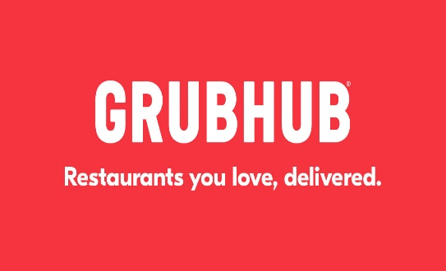
Product Description
GrubHub is an online food ordering company, Which connect connects users with local restaurants

Slide 5
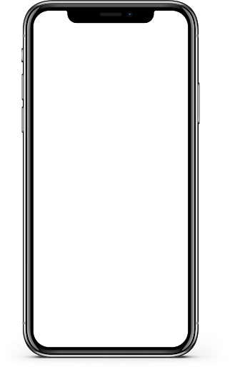
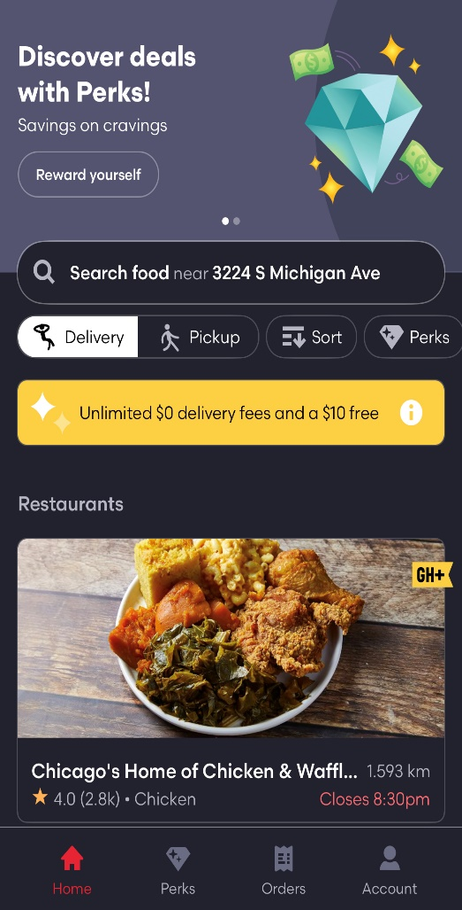
GrubHub Application Provides the High visibility by allowing four basic tabs linked to each page. Featuring direct link to home and accounts tab. Improved visibility heuristic can be determined from the Maps integration that gives user live progress over their delivery. Scope: Various representative symbols, animations conveys the hidden progress helping users to know progress of their task.
Visibility

Slide 6

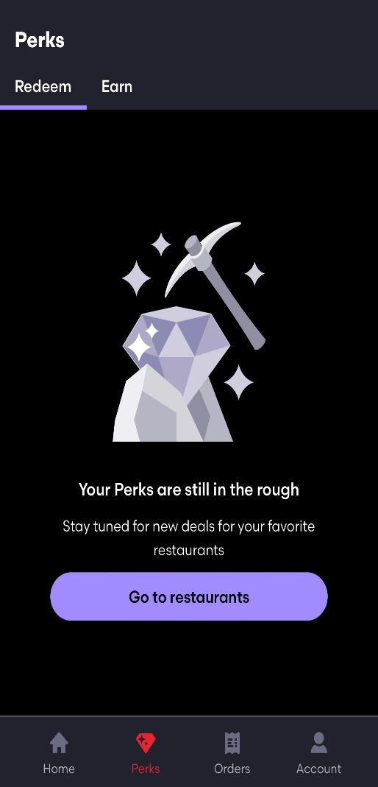
As we can see while using the GrubHub Application when user came across Login and network related queries in such cases GrubHub represents the problem in real world language with steps to solve the respective issue. Scope: Exact error representation with use of Real-World doodles creates significant effect on users understanding.
Match Between the System and the real world

Slide 7
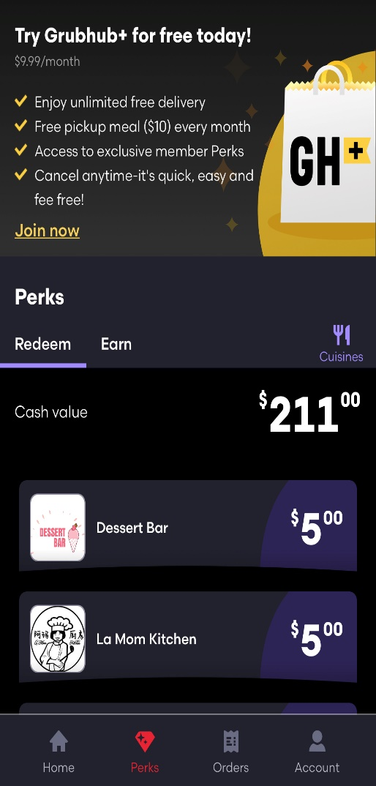
Quick Access Tool Bar on each interface allow user to quickly exit out the current task they are performing. Scope: Ease of use can be accomplished by making most important section easily Accessible.
User Control and Freedom

Slide 8
Problem: Inconsistent Layout Reason : The settings Tab in the Grubhub application contains unnecessary format change. Scope: User can significantly notice unnecessary design changes. Severity: Rating: Low Rational: It is not threat to the actual functionality of the application.
Consistency and Standards

Slide 9
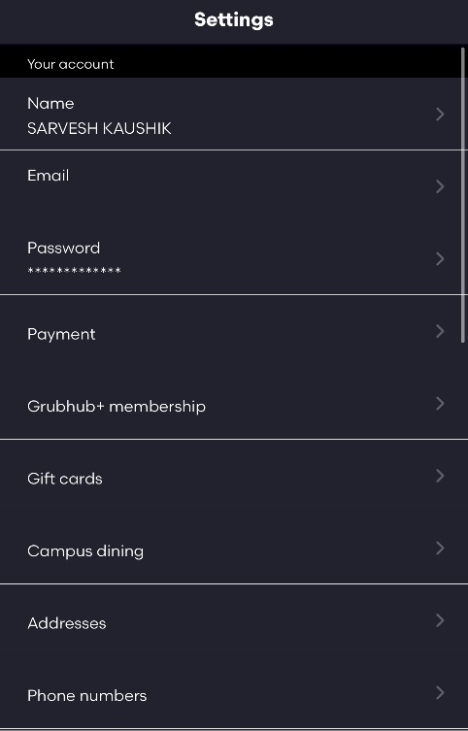
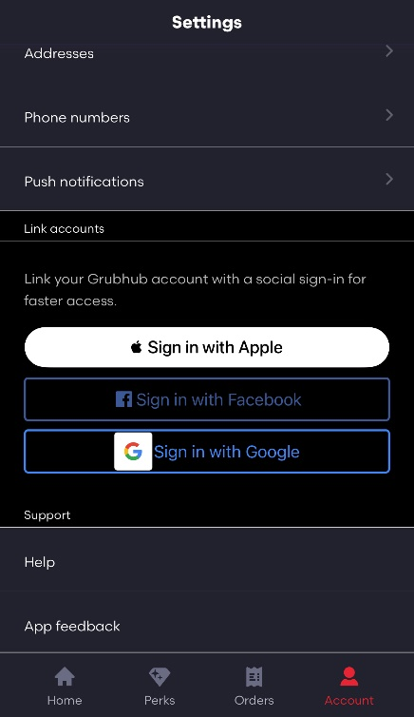
Solution: The Link account section must match with the rest of the contents in terms of font, color and Aesthetics.
Consistency and Standards

Slide 10
Accurate Search Bar Provides the instant search result saving user time and possibility to enter wrong address. Google+ direct sign is feature eliminate need of remembering the password and UserId while logging each time. Scope: Faster user interaction with each section sue to guided information resulting in less user prone errors.
Error Prevention

Slide 11
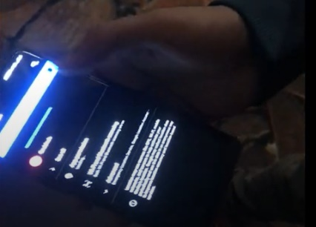
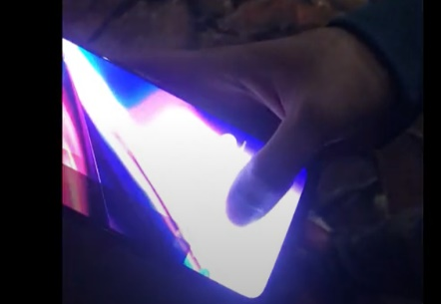
Problem: Force Exit Reason : At some point when searching for new restaurant if user tries to enable its current location after few seconds it the application force exit user out of the interface. Scope: It can heavily interrupt use ordering process. Severity: Rating: High Rational: It is important for application to work as displayed. Solution: Internal modification of page redirection and bug fixes are necessary. As user share its location he should see his location already mapped in the search bar without facing force exiting.
Error Recovery

Slide 12
Problem: No Favourite Lists Reason : Ordering previously ordered dish could cause extra overhead incursion for the users as they have to go through order history and manually search for the dish name and the date. Scope: It can cause user inconvenience. Severity: Rating:Medium Rational:User likes the interfaces that helps them every step during their transaction. Solution: Better to create user favourite list and pin items when user try to search a specific restaurants from their history automatically as a suggestions. User can keep track of favourite items and order them in a single touch from separate interface.
Recognition Rather than Recall

Slide 13
Exclusive perks provides flexible discount attribute which can be automatically applied at the checkout. Pickup and delivery section with Maps Integration effectively helps users to select the appropriate order location. Scope: Smooth Transition with effective results over each operation performed through the application.
Flexibility and Efficiency

Slide 14
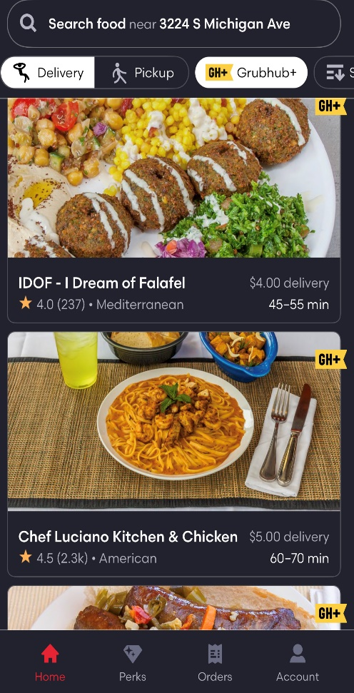
Color rich interface includes modern black background matched with the dark red color. Gives a modern and attractive feel to the application. Scope: Smooth Transition with effective results over each operation performed through the application.
Aesthetic and the Minimalist design

Slide 15
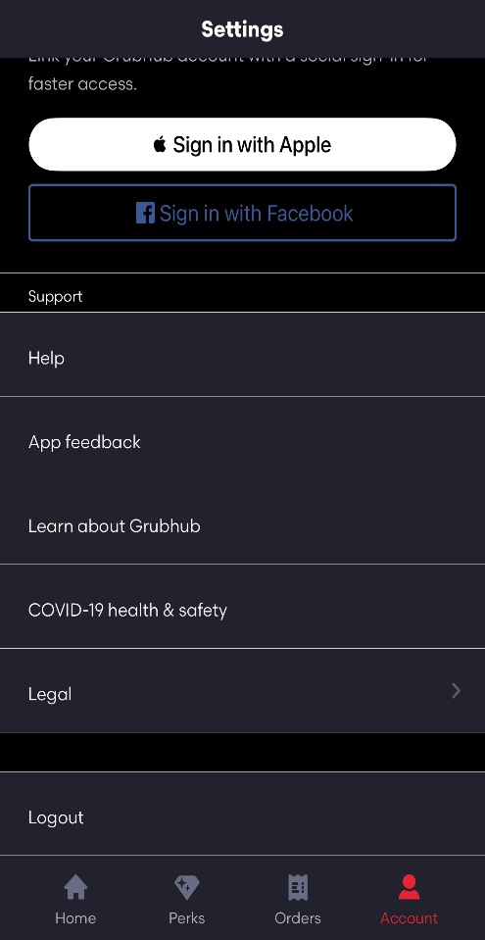
Sperate section in the setting tabs that is devoted to the help and he feedback. Where user can find the FAQ’s with live customer support. Scope: Detailed Guidance provided to the most basic steps with additional customer support option enabling better navigation.
Help and the Documentation

Slide 16
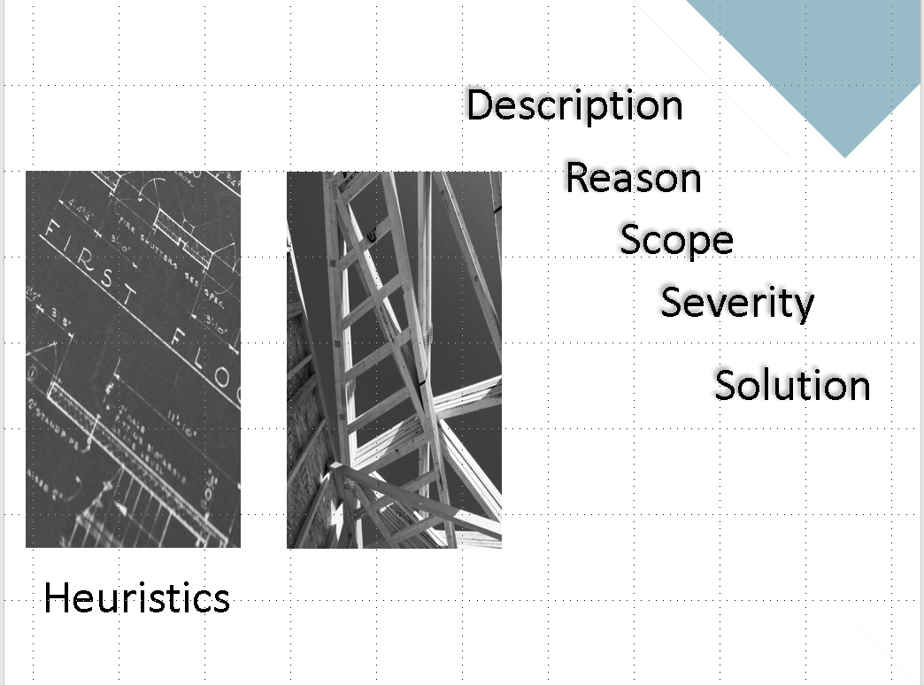

Slide 17







Trying to Sign In
Observing different lists
Doing custom search on restaurants
$25
Adding Different Items into the cart
Pay and checkout
Wait and Track the order

